Slide 1
Property Rights in Man
Range in types serfdom and slavery
Range in duration from short-term rental contracts (wage) to long term slavery
Range in degree of completeness
encomiendas (use rights) to slavery including sale and rental rights
Prevalence in both DCs and LDCs

Slide 2
Two Ends of the Slavery Institutions
Enslaving
Making use of slaves and maintaining the system
Common questions:
1. What causes its emergence?
2, What causes its demise?
3. What are its effects?

Slide 3
How Can It Be Beneficial to Producers (Slaveowners)
Extra powers of coercion and incentives to extract effort (may not be very different than HHs under very autocratic heads with absolute power)
May induce higher LFPR by specialization so that more women freed to participate
Use as collateral, allows user to obtain credit and more scarce inputs into production
Non-economic benefits (prestige, beauty)
May be able to pay them less than would be the case with voluntary labor
May induce investments in human capital, at least under certain circumstances

Slide 4
Emergence
Often when other means of securing labor at prevailing wages failed (e.g., imported convict labor, use of native pop. in the Americas)
Often when economies of scale can be exploited as in plantation crops, economies of scope in supervision
When labor is scarce relative to land
Domar Model

Slide 5
Domar Model and Critique Thereof
Land-labor ratio is high
Class of landowners and another of non-landowners
Technology that can make profitable use of the “free land” as long as workers can be prevented from moving and taking free land for themselves. The profitable use is that wage can be above subsistence level.
Demise being Malthusian growth of pop so that wage is pushed down to subsistence level and no longer a benefit to maintain the system

Slide 6
The two Stages
1. Setting it Up may involve high costs:
  those of obtaining the slaves, unless by conquest
  Psychic costs of immorality unless obtained through conquest
  If the slaves at beginning include many children and elderly there may be many fixed costs
  Paying transport and sharing profits with the enslavers and transporters

Slide 7
1. Additional Set Up Costs
Cartel among slaveowners not to take runaways from other owners
Should not be possible for runaways to vanish and be absorbed by their friends and kin in subsistence sector. (this would be very high when the origin was local)
Supervision costs but this lowered in economies of scale when production done on group basis

Slide 8
2. Maintenance of the System
Once set up, however, every slave owner has a strong incentive to maintain the system to allow it to continue, thus maintaining the value of their capital stock
Not necessarily the case that slaves very unhappy or worse off: paternalistic care possibilities of free labor may have been very poor such that people would prefer slavery
Some slaves very well off and in some cases are owners themselves

Slide 9
How to Explain Demise of Slavery
Not clear that demise associated with Malthusian growth of pop and fall in surplus over subsistence to zero
Desire for freedom on part of slave: Manumission (self-purchase) would be in owner;’s interest but this did not occur even in urban areas of US South with skilled labor where it might have been practical. Cuban example of laws requiring owners to specify price for slave to accomplish this

Slide 10
Sources of demise
English serfdom: schism in the owners group that benefits the serfs
Haiti: slave revolution (Kloosterboer )
Russia: threat of peasant rebellion causes czar to act to end serfdom despite the objection of the lords (Blum)
US could be seen as war between the slave owning and non-slaveowning elites in which the latter won (Engerman)
After demise, plantation owners tried to obtain many of the same features in other means: discrimination. Use of share contracts

Slide 11
More Demise Theories
Declining Profitability
Means of compensating former owners
Brazilian case Trade stopped externally by Britain, but continues domestically but with declining number of slaves. Value goes up

Slide 12
Long Term Effects
Nathan Nunn 2005,2006
Develops a model characterized by path dependence and multiple equilibria which explains how past experience with slave trade could continue to explain underdevelopment at present.
When external extraction is sufficiently severe, it causes a society to move from a high equilibrium to a low one in which it gets trapped.

Slide 13
Empirical Findings of Nunn
Number of slaves exported 1400-1913 is an important determinant of economic performance in late 20th Century.
His hypothesis tries to capture and demonstrate the basis for the impression of the effects suggested by economic and other historians of Africa (Bairoch 1993, Manning 1990, p 124) ”Slavery was corruption: it involved theft, bribery and exercise of brute force as well as ruses. Slavery thus may be seen as one source ….of modern corruption.”

Slide 14
Characterization of the process
Studies of particular tribes like Balanta of Guinea-Bissau, Minyanka of Mali showing their role in raiding on other tribes but often themselves
More than half the slaves were taken by slave raiders and another 20% by kidnappings by state sponsored raiding parties, bandits
European demand for slaves gave rise to proliferation of raiding groups all over Africa (Inikori 2000). Some obtained by judicial outcomes as alternative to beatings, prison, debts., witchcraft,
This impeded the development of centralized states.
These societies were powerless to prevent the slave raiding devastation. Only Oyo in Dahomey and Asante in West Africa were able to maintain their own law and order during this period

Slide 15
Data
Numbers of slaves exported from each region or port in Africa: “shipping data” from shipping records from Trans-Atlantic Slave Trade database and other sources for other regions
Ethnicity of slaves as reported in the countries of destination . This data not as extensive, and barely exists at all for Red Sea slave trade
Matches the two sources to distribute the number exported from each port to the countries of origin in the region, much to the interior of these ports.

Slide 16
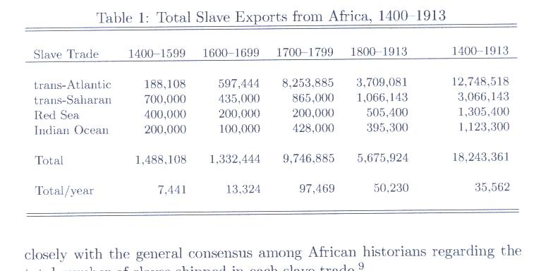

Slide 17
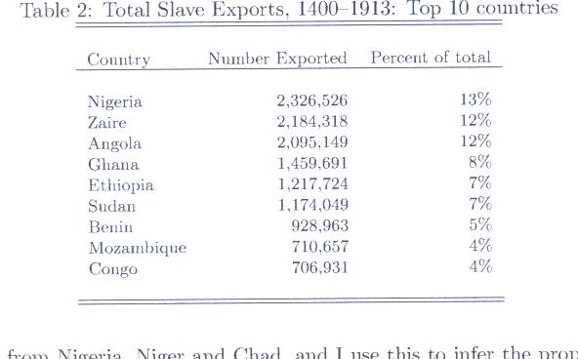

Slide 18
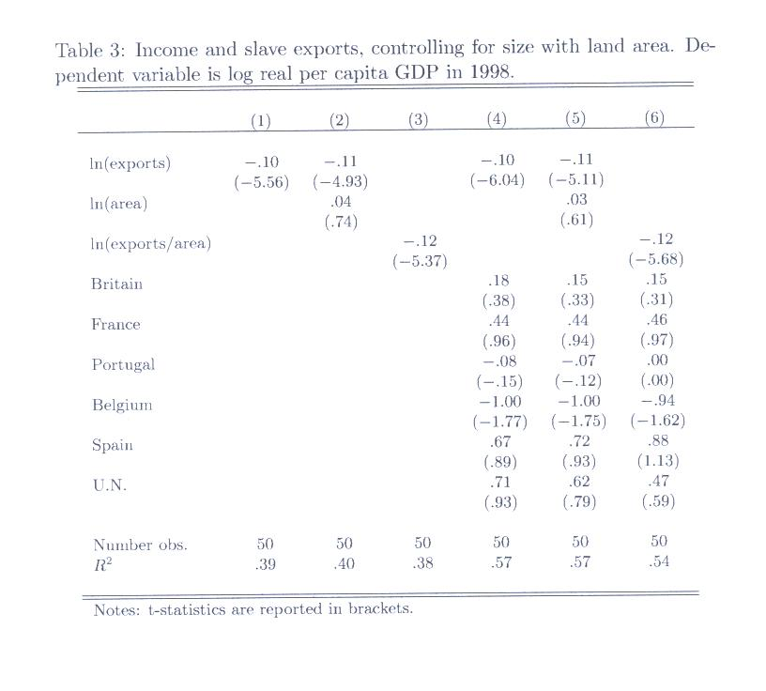

Slide 19
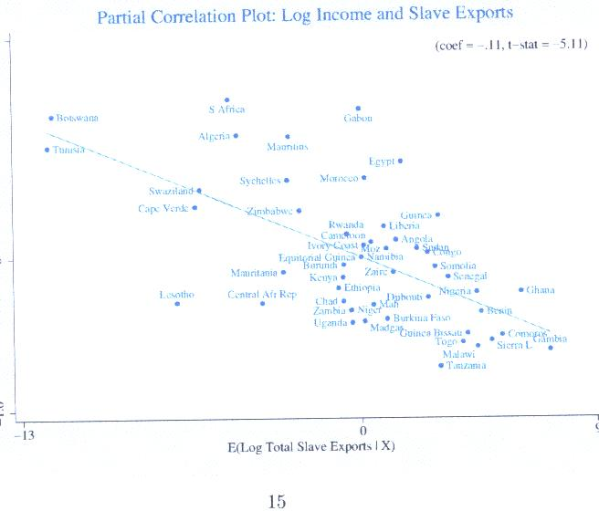

Slide 20
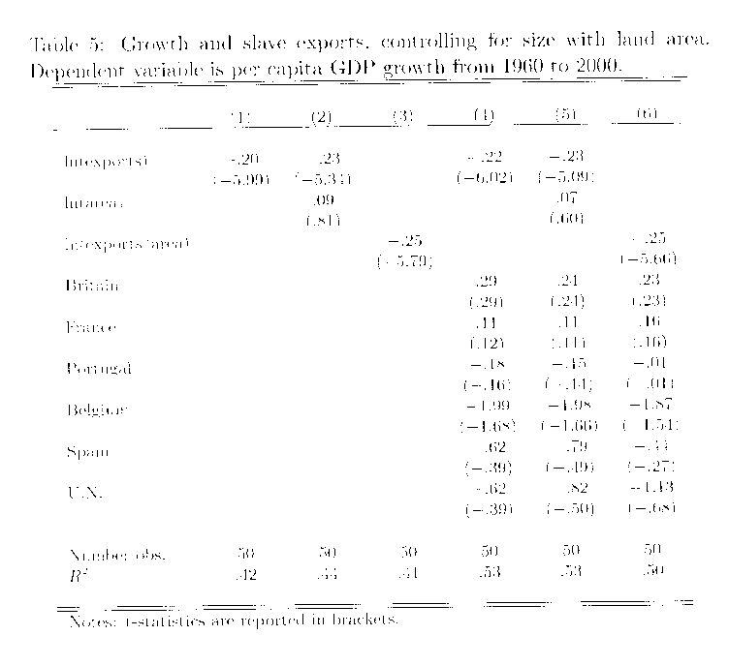

Slide 21
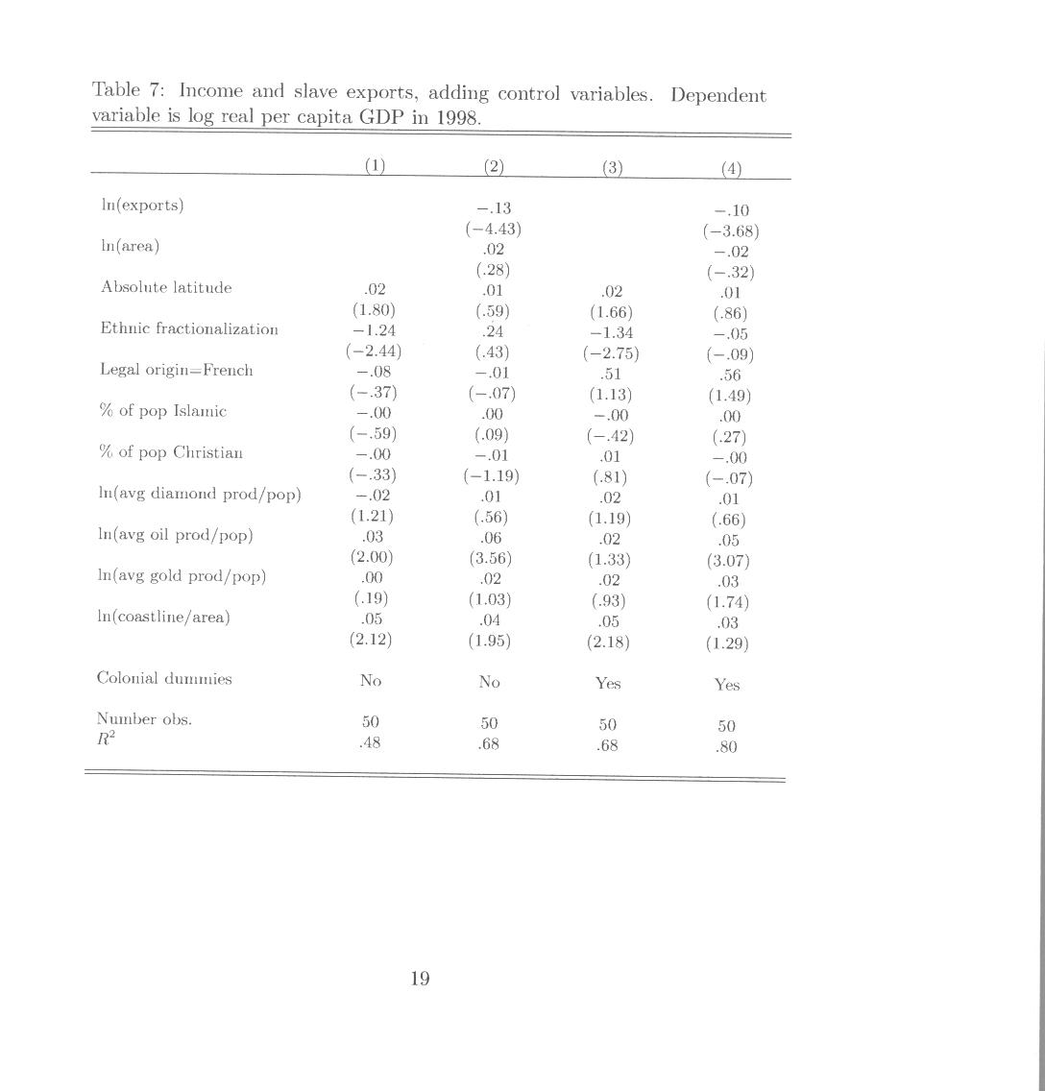

Slide 22
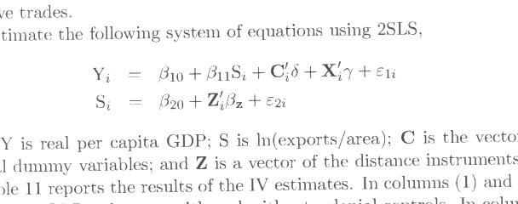
Instrumenting for Slave Exports

Slide 23
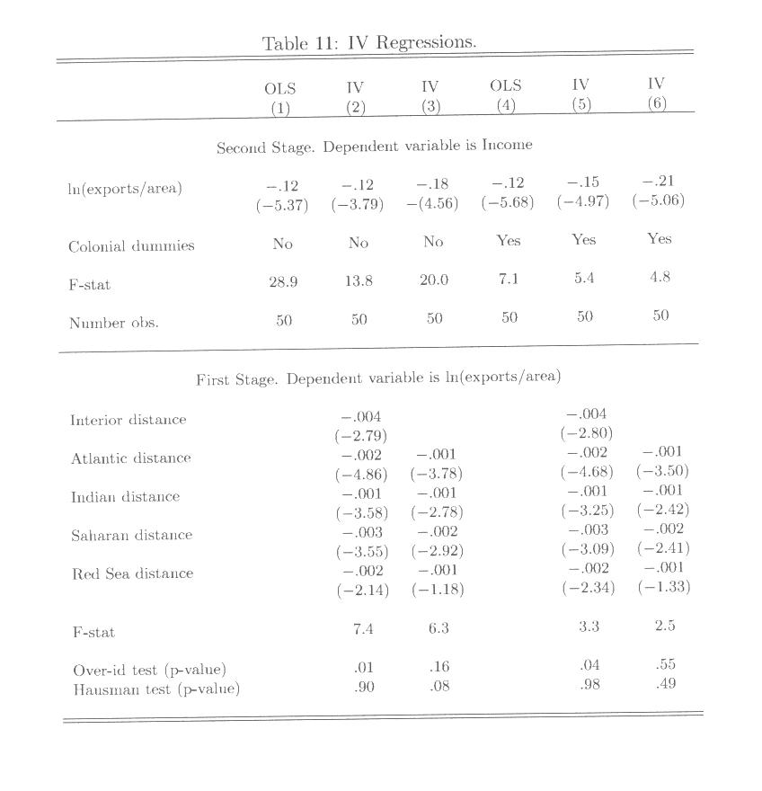

Slide 24
What Is the Channel for the Effect?
Use Alternative Institutional Variables
Then Instrument these with the Use of Slave Exports
Finally seeing whether Rule of Law is the exclusive channel

Slide 25
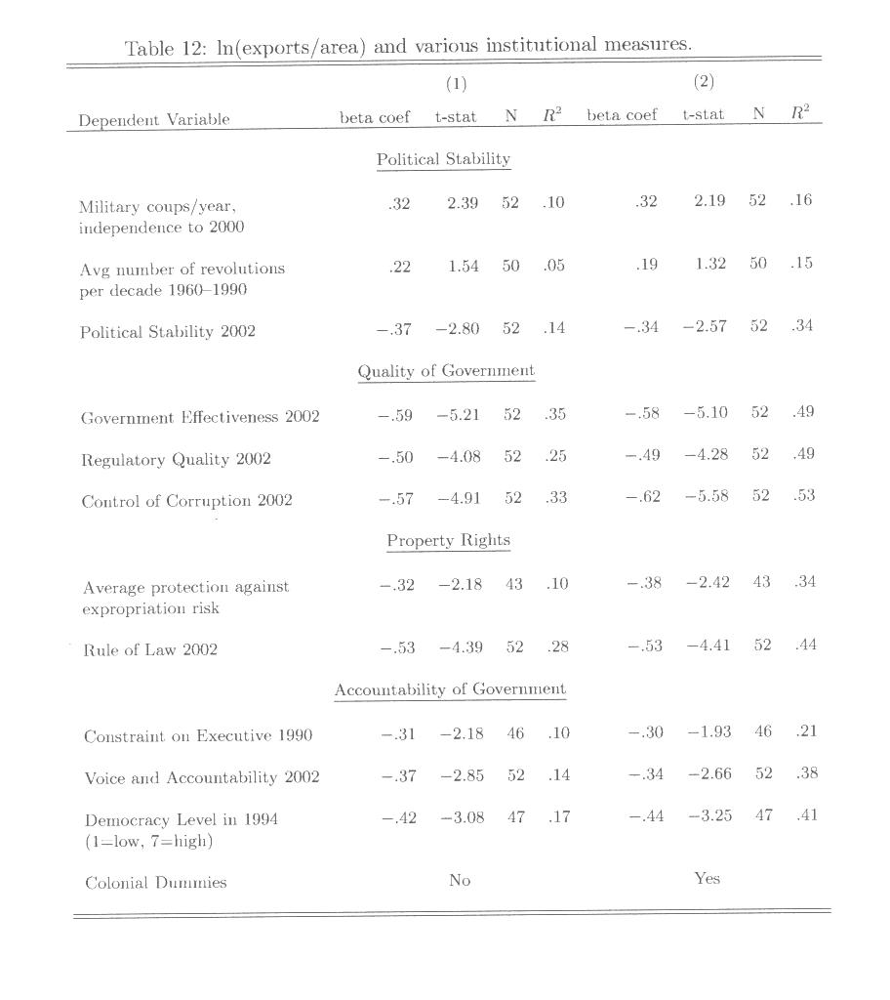

Slide 26
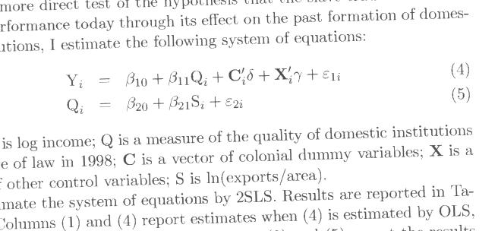

Slide 27
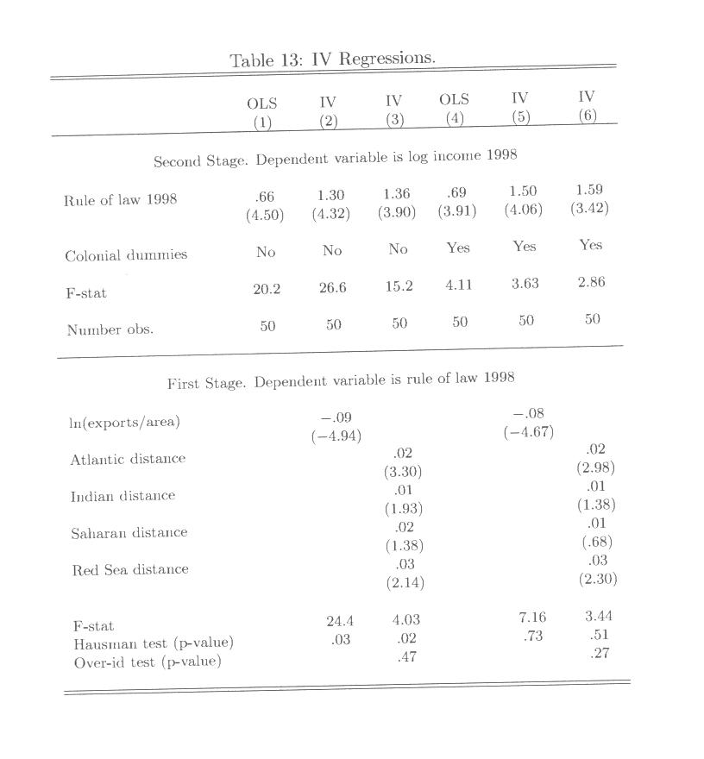

Slide 28
Nunn’s Conclusions
Slave Exports traced back to country of origin had a long-term negative effect on both level of income 1998 and growth rate 1960-98
The channel seems to be rule of law.
This channel seemed to be exclusive.
These results consistent with the notion that the external intervention to capture slaves undermined what might have been better governance at the time

Slide 29
African Slavery
Meillassoux 1991 shows that it existed at least since 800AD. Slaves generally worked in the service of tribal rulers. Prisoners captured in tribal conflicts and distributed among the tribe
Slaves used because of shifting agriculture which meant much labor needed to clear land which had to be abandoned once productivity started to decline.
Slaves were often paid wages and allowed to accumulate property (Clarence-Smith 1989). This was therefore far less permanent than when slaves were exported

Slide 30
Methods of obtaining slaves Gemery and Hogendorn 1979
Capture through conflicts among kingdoms
Kidnap
Weaker communities would offer slaves to maintain peace with stronger rivals
Muslim merchants coming to Africa saw the commercial promise of applying slaves to production of the goods they brought with them
Its profitability encouraged its expansion
It differed from serfdom in that slave owners had incentive to make sure that the slave would surve (Hence more paternalistic.

Slide 31
As the export trade expanded
Europeans rarely ventured inland
While first Africans to Americas were indentured servants, their voluntary supply was insufficient, leading to their replacement with slaves
Hence the internal procurement and transport was done by African tribes
  Ashanti of Ghana
  Dahomey of Benin which dominated 1700-1892 when conquered by French. All land owned by the Dahomey king
  Yoruba of Nigeria
  Ibangala of Angola
  Nyamwezi of Tanzania
  According to Lovejoy 1983 this transformed African economy into a more hierarchical, militarized one in 3 period Kinship based only until 1600
  The slaves sold for weapons, manufactures, alcohol as part of three way trade involving sugar and rum from the new world
  The production of tropical products in the Americas undermined the profitability of producing these in Africa since the cost of production was lower.

Slide 32
Changes over time
As slavery expands, the areas from which slaves came became depopulated.
  Slave owners did not want their slaves to procreate since pregnant slaves were not productive
  Sold for weapons. Then population lees these areas.
  Eventual demise due to depopulation and eventually international pressures to stop it.
  The decline in slave trade in mid 19th century led to more use of slaves domestically to produce crops. (Ellis 1965) . Rise in African exports (Abdul Sheriff 1987). But did not stimulate investment

Slide 33
Miers and Kopytoff: Duala Slave Trade in Cameroon
From 16th to 20th Centuries
Duala numbered 20,000 out of Cameroon’s pop. Of 2 million. But the occupied key river and near coastal areas
They were not cultivators but traders, slaves were used as crew in transport. But in 1900 Germans encouraged Duala to enter agric. (cocoa). In 1884 they had also tried to bypass the Duala as middlemen. In 1902 they promolgated an ordinance to abolish internal slavery.

Slide 34
Other Characteristics of Duala Trade
Slaves were exchanged internally among Duala as with currency
It contributed to the Duala’s belief in their own superiority as well as to their economic progress.
Slave price varied considerably over time according to external demand
Slaves valuable in staffing fishing expeditions, obtained young, brought up as apprentices which made them more valuable in production
Transfer internally from surplus and poor interior locations to coastal and areas where they were trained had a benign effect
The end of slavery was a result of political rather than economic forces
Since their needs were never great, they did not become marauders , bandits. Purchase was main method of obtaining them. Many slaves obtained in voluntary exchange and some slaves may not have wanted to be freed. Cameroon was less adversely affected by slavery than other African countries. But colonialism of Germans was very harmful

